Slide 1

Ethics in Information Technology, Second Edition
Chapter 6
Intellectual Property

Slide 2
Objectives
What does the term intellectual property encompass, and why are companies so concerned about protecting it?
What are the strengths and limitations of using copyrights, patents, and trade secret laws to protect intellectual property?
What is plagiarism, and what can be done to combat it?
Ethics in Information Technology, Second Edition

Slide 3
Objectives (continued)
What is reverse engineering, and what issues are associated with applying it to create a look-alike of a competitor’s software program?
What is open source code, and what is the fundamental premise behind its use?
What is the essential difference between competitive intelligence and industrial espionage, and how is competitive intelligence gathered?
Ethics in Information Technology, Second Edition

Slide 4
Objectives (continued)
What is cybersquatting, and what strategy should be used to protect an organization from it?
Ethics in Information Technology, Second Edition

Slide 5
What is Intellectual Property?
Term used to describe works of the mind
  Distinct and “owned” or created by a person or group
Copyright law
  Protects authored works
Patent laws
  Protect inventions
Trade secret laws
  Help safeguard information critical to an organization’s success
Ethics in Information Technology, Second Edition

Slide 6
Copyrights
Established in the U.S. Constitution
  Article I, section 8, clause 8
Grants creators of original works the right to
  Distribute
  Display
  Perform
  Reproduce work
  Prepare derivative works based upon the work
  Author may grant exclusive right to others
Ethics in Information Technology, Second Edition

Slide 7
Copyrights (continued)
Types of work that can be copyrighted
  Architecture
  Art
  Audiovisual works
  Choreography
  Drama
  Graphics
  Literature
  Motion pictures
Ethics in Information Technology, Second Edition

Slide 8
Copyrights (continued)
Types of work that can be copyrighted
  Music
  Pantomimes
  Pictures
  Sculptures
  Sound recordings
  Other intellectual works
    As described in Title 17 of U.S. Code
Ethics in Information Technology, Second Edition

Slide 9
Copyrights (continued)
Work must fall within one of the preceding categories
Must be original
  Evaluating originality can cause problems
Fair use doctrine
  Factors to consider when evaluating the use of copyrighted material
Ethics in Information Technology, Second Edition

Slide 10
Copyrights (continued)
Fair use doctrine factors include:
  Purpose and character of the use
  Nature of the copyrighted work
  Portion of the copyrighted work used
  Effect of the use upon the value of the copyrighted work
Copyright infringement
  Copy substantial and material part of another’s copyrighted work
  Without permission
Ethics in Information Technology, Second Edition

Slide 11
Copyrights (continued)
Area of copyright infringement
  Worldwide sale of counterfeit consumer supplies
Copyrights to protect computer software exist
  To prove infringement, copyright holders must show a striking resemblance between the original software and the new software that could be explained only by copying
World Intellectual Property Organization (WIPO)
  Agency of the United Nations
  Advocates for the interests of intellectual property owners
Ethics in Information Technology, Second Edition

Slide 12
Copyrights (continued)
Digital Millennium Copyright Act (DMCA)
  Added new provisions to WIPO
  Civil and criminal penalties included
  Governs distribution of tools and software that can be used for copyright infringement
  Opponents say it restricts the free flow of information
Ethics in Information Technology, Second Edition

Slide 13
Patents
Grant of property rights to inventors
Issued by the U.S. Patent and Trademark Office (USPTO)
Permits an owner to exclude the public from making, using, or selling the protected invention
Allows legal action against violators
Prevents independent creation
Extends only to the United States and its territories and possessions
Ethics in Information Technology, Second Edition

Slide 14
Patents (continued)
Applicant must file with the USPTO
  USPTO searches prior art
  Takes an average of 25 months
Prior art
  Existing body of knowledge
  Available to a person of ordinary skill in the art
Ethics in Information Technology, Second Edition

Slide 15
Patents (continued)
An invention must pass four tests
  Must be in one of the five statutory classes of items
  Must be useful
  Must be novel
  Must not be obvious to a person having ordinary skill in the same field
Items cannot be patented if they are
  Abstract ideas
  Laws of nature
  Natural phenomena
Ethics in Information Technology, Second Edition

Slide 16
Patents (continued)
Patent infringement
  Someone makes unauthorized use of a patent
  No specified limit to the monetary penalty
Software patent
  Feature, function, or process embodied in instructions executed on a computer
20,000 software-related patents per year have been issued since the early 1980s
Ethics in Information Technology, Second Edition

Slide 17
Patents (continued)
Before obtaining a software patent, do a patent search
Software Patent Institute is building a database of information
Cross-licensing agreements
  Large software companies agree not to sue others over patent infringements
  Small businesses have no choice but to license patents
Ethics in Information Technology, Second Edition

Slide 18
Patents (continued)
Defensive publishing
  Alternative to filing for patents
  Company publishes a description of the innovation
  Establishes the idea’s legal existence as prior art
  Costs mere hundreds of dollars
  No lawyers
  Fast
Ethics in Information Technology, Second Edition

Slide 19
Patents (continued)
Standard is a definition or format
  Approved by recognized standards organization
  Or accepted as a de facto standard by the industry
  Enables hardware and software from different manufacturers to work together
Submarine patent
  Hidden within a standard
  Does not surface until the standard is broadly adopted
Ethics in Information Technology, Second Edition

Slide 20
Patents (continued)
Patent farming involves
  Influencing a standards organization to make use of a patented item
  Demanding royalties from all parties that use the standard
Ethics in Information Technology, Second Edition

Slide 21
Trade Secret Laws
Uniform Trade Secrets Act (UTSA) established uniformity in trade secret law
Trade secret
  Business information
  Represents something of economic value
  Requires an effort or cost to develop
  Some degree of uniqueness or novelty
  Generally unknown to the public
  Kept confidential
Computer hardware and software can qualify for trade secret protection
Ethics in Information Technology, Second Edition

Slide 22
Trade Secret Laws (continued)
Information is only considered a trade secret if the company takes steps to protect it
Greatest threat to loss of company trade secrets is employees
Nondisclosure clauses in employee’s contract
  Enforcement can be difficult
  Confidentiality issues are reviewed at the exit interview
Ethics in Information Technology, Second Edition

Slide 23
Trade Secret Laws (continued)
Noncompete agreements
  Protect intellectual property from being used by competitors when key employees leave
  Require employees not to work for competitors for a period of time
Safeguards
  Limit outside access to corporate computers
  Guard use of remote computers by employees
Ethics in Information Technology, Second Edition

Slide 24
Trade Secret Laws (continued)
Trade secret law has a few key advantages over patents and copyrights
  No time limitations
  No need to file an application
  Patents can be ruled invalid by courts
  No filing or application fees
Law doesn’t prevent someone from using the same idea if it is developed independently
World Trade Organization (WTO)
  TRIPs Agreement provides for a minimum level of protection for intellectual property
Ethics in Information Technology, Second Edition

Slide 25
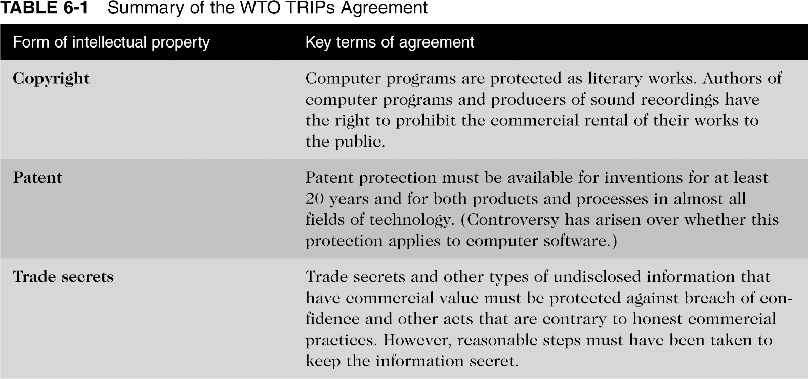
Summary of the WTO TRIPs Agreement
Ethics in Information Technology, Second Edition

Slide 26
Legal Overview: The Battle Over Customer Lists
Employees make unauthorized use of an employer’s customer list
  Customer list not automatically considered a trade secret
  Educate workers about the confidentiality of such lists
Ethics in Information Technology, Second Edition

Slide 27
Key Intellectual Property Issues
Issues that apply to intellectual property and information technology
  Plagiarism
  Reverse engineering
  Open source code
  Competitive intelligence
  Cybersquatting
Ethics in Information Technology, Second Edition

Slide 28
Plagiarism
Theft and passing off of someone’s ideas or words as one’s own
Many students
  Do not understand what constitutes plagiarism
  Believe that all electronic content is in the public domain
Plagiarism detection systems
  Check submitted material against databases of electronic content
Ethics in Information Technology, Second Edition

Slide 29
Plagiarism (continued)
Steps to combat student plagiarism
  Help students understand what constitutes plagiarism
  Show students how to document Web pages
  Schedule major writing assignments in portions
  Tell students that you know about Internet paper mills
  Educate students about plagiarism detection services
Ethics in Information Technology, Second Edition

Slide 30
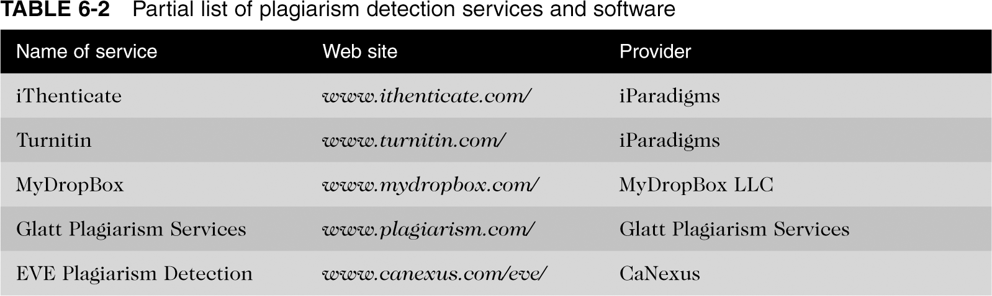
Partial List of Plagiarism Detection Services and Software
Ethics in Information Technology, Second Edition

Slide 31
Reverse Engineering
Process of taking something apart in order to
  Understand it
  Build a copy of it
  Improve it
Applied to computer
  Hardware
  Software
Convert a program code to a higher level design
Convert an application that ran on one vendor’s database to run on another’s
Ethics in Information Technology, Second Edition

Slide 32
Reverse Engineering (continued)
Compiler
  Language translator
  Converts computer program statements expressed in a source language to machine language
Software manufacturer
  Provides software in machine language form
Decompiler
  Reads machine language
  Produces source code
Ethics in Information Technology, Second Edition

Slide 33
Reverse Engineering (continued)
Courts have ruled in favor of using reverse engineering
  To enable interoperability
Software license agreements forbid reverse engineering
Semiconductor Chip Protection Act (SCPA)
  Established a new type of intellectual property protection for mask works
Ethics in Information Technology, Second Edition

Slide 34
Open Source Code
Program source code made available for use or modification
  As users or other developers see fit
Basic premise
  Software improves
  Can be adapted to meet new needs
  Bugs rapidly identified and fixed
High reliability
GNU General Public License (GPL) was a precursor to the Open Source Initiative (OSI)
Ethics in Information Technology, Second Edition

Slide 35
Competitive Intelligence
Gathering of legally obtainable information
  To help a company gain an advantage over rivals
Often integrated into a company’s strategic plans and decision making
Not industrial espionage
Nearly 25 colleges and universities offer courses or programs
Without proper management safeguards it can cross over to industrial espionage
Ethics in Information Technology, Second Edition

Slide 36
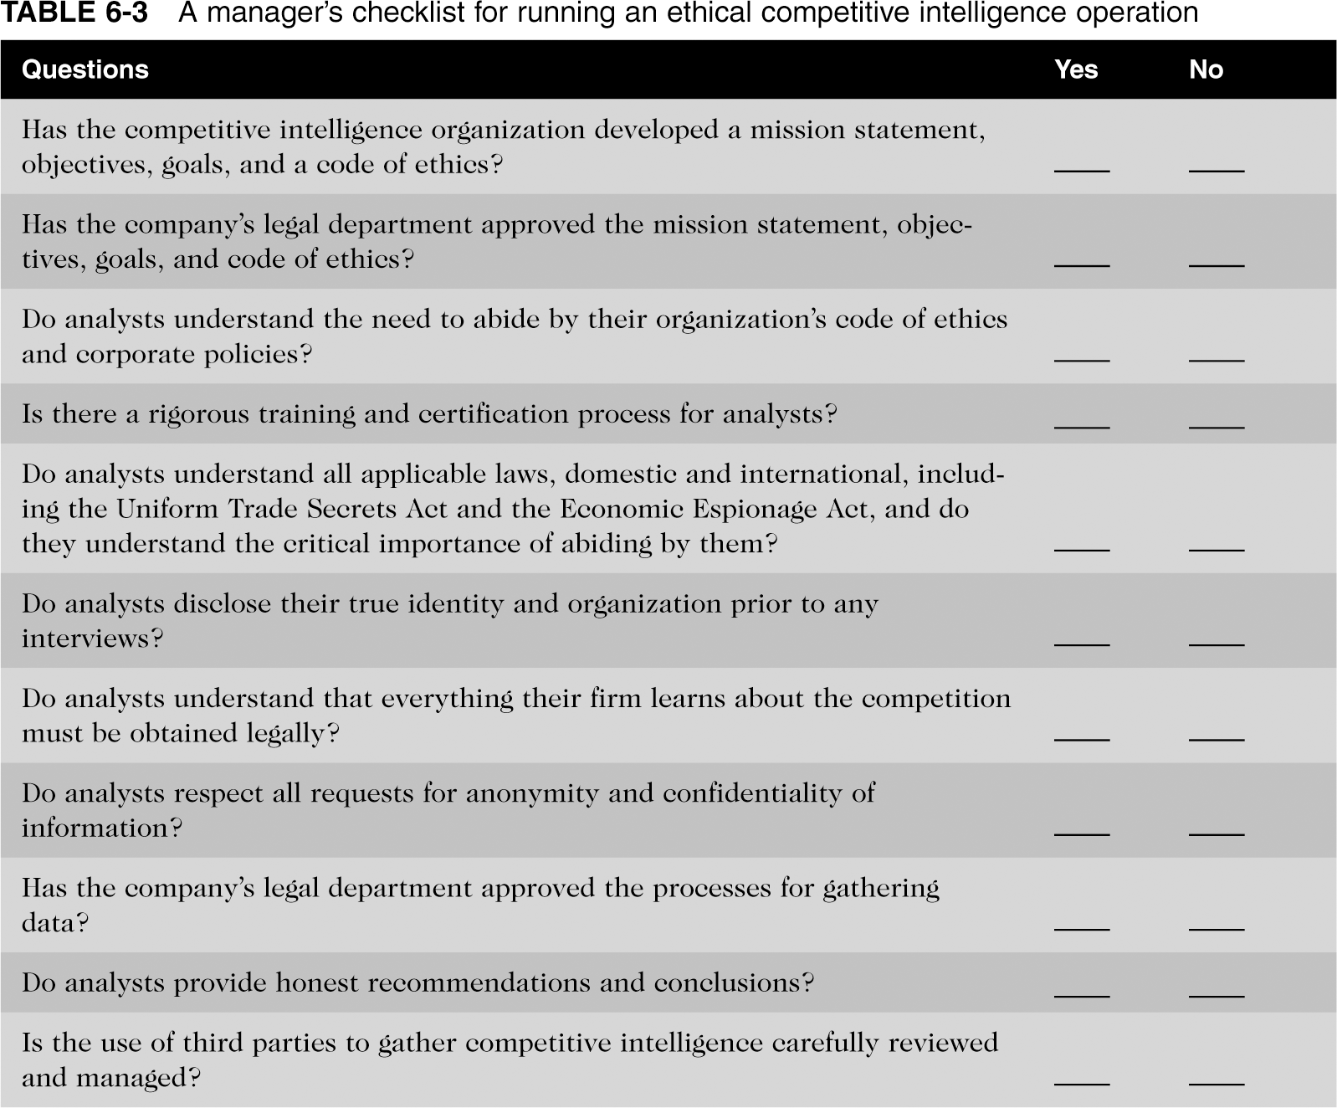
A Manager’s Checklist for Running an Ethical Competitive Intelligence Operation
Ethics in Information Technology, Second Edition

Slide 37
Cybersquatting
Trademark is anything that enables a consumer to differentiate one company’s products from another’s
  May be
    Logo
    Package design
    Phrase
    Sound
    Word
Ethics in Information Technology, Second Edition

Slide 38
Cybersquatting (continued)
Trademark law
  Trademark’s owner has the right to prevent others from using the same mark
    Or confusingly similar mark
Cybersquatters
  Registered domain names for famous trademarks or company names
  Hope the trademark’s owner would buy the domain name
    For a large sum of money
Ethics in Information Technology, Second Edition

Slide 39
Cybersquatting (continued)
To curb cybersquatting
  Register all possible domain names
    .org
    .com
    .info
Internet Corporation for Assigned Names and Numbers (ICANN)
  Current trademark holders are given time to assert their rights in the new top-level domains before registrations are opened to the general public
Ethics in Information Technology, Second Edition

Slide 40
Summary
Intellectual property is protected by
  Copyrights
  Patents
  Trade secrets
Plagiarism is stealing and passing off the ideas and words of another as one’s own
Reverse engineering
  Process of breaking something down
  In order to understand, build copy, or improve it
Ethics in Information Technology, Second Edition

Slide 41
Summary (continued)
Open source code
  Made available for use or modification as users or other developers see fit
Competitive intelligence
  Not industrial espionage
  Uses legal means and public information
Cybersquatting
  Registration of a domain name by an unaffiliated party
Ethics in Information Technology, Second Edition

